Slide 1
K-Means Clustering FAI-UNIT-V

Slide 2
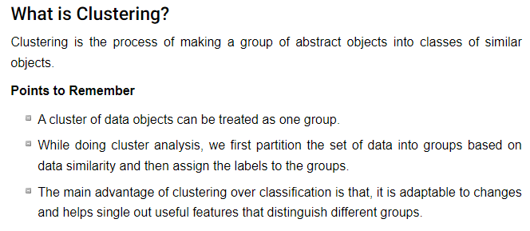
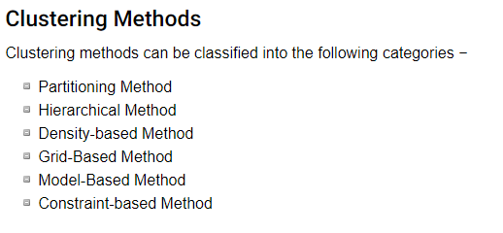

Slide 3
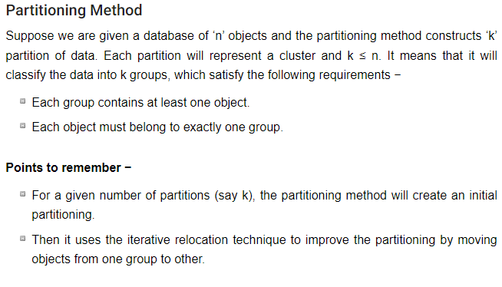
Clustering Techniques

Slide 4
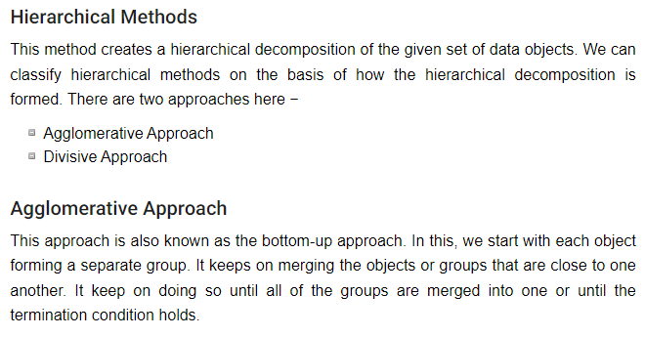
Clustering Techniques

Slide 5
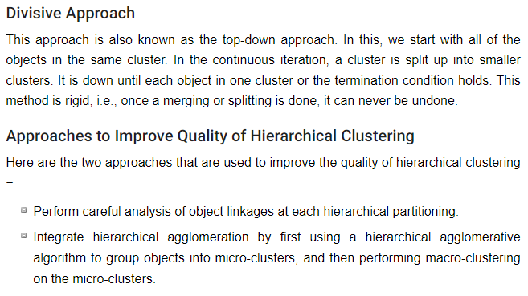
Clustering Techniques

Slide 6
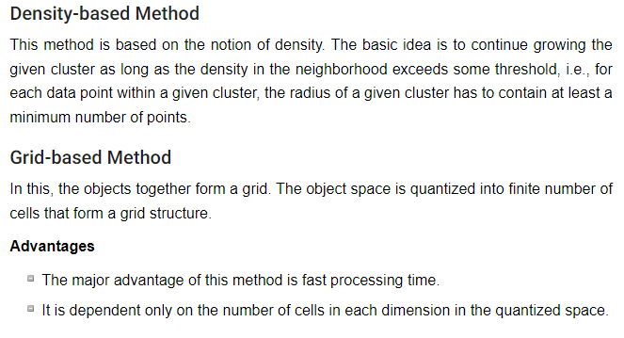
Clustering Techniques

Slide 7
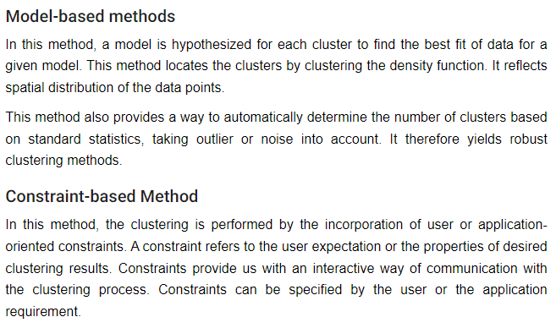
Clustering Techniques

Slide 8
Clustering Techniques
Partitioning approach:
Construct various partitions and then evaluate them by some criterion, e.g., minimizing the sum of square errors
Typical methods: k-means, k-medoids, CLARANS
Hierarchical approach:
Create a hierarchical decomposition of the set of data (or objects) using some criterion
Typical methods: Diana, Agnes, BIRCH, ROCK, CAMELEON
Density-based approach:
Based on connectivity and density functions
Typical methods: DBSACN, OPTICS, DenClue

Slide 9
Clustering Techniques
Grid-based approach:
based on a multiple-level granularity structure
Typical methods: STING, WaveCluster, CLIQUE
Model-based:
A model is hypothesized for each of the clusters and tries to find the best fit of that model to each other
Typical methods: EM, SOM, COBWEB
Frequent pattern-based:
Based on the analysis of frequent patterns
Typical methods: pCluster
User-guided or constraint-based:
Clustering by considering user-specified or application-specific constraints
Typical methods: COD (obstacles), constrained clustering

Slide 10
Calculation of Distances
Single link: smallest distance between an element in one cluster and an element in the other, i.e., dis(K_{i}, K_{j}) = min(t_{ip}, t_{jq})
Complete link: largest distance between an element in one cluster and an element in the other, i.e., dis(K_{i}, K_{j}) = max(t_{ip}, t_{jq})
Average: avg distance between an element in one cluster and an element in the other, i.e., dis(K_{i}, K_{j}) = avg(t_{ip}, t_{jq})
Centroid: distance between the centroids of two clusters, i.e., dis(K_{i}, K_{j}) = dis(C_{i}, C_{j})
Medoid: distance between the medoids of two clusters, i.e., dis(K_{i}, K_{j}) = dis(M_{i}, M_{j})
Medoid: one chosen, centrally located object in the cluster

Slide 11
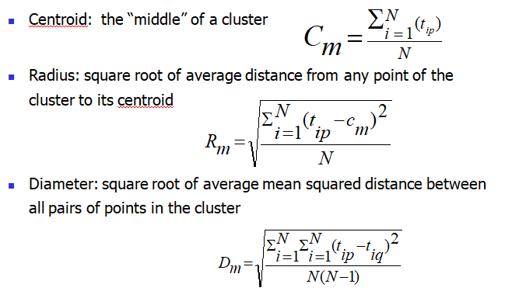

Slide 12
K- means Clustering
K-Means Clustering is an unsupervised learning algorithm that is used to solve the clustering problems in machine learning or data science. In this topic, we will learn what is K-means clustering algorithm, how the algorithm works, along with the Python implementation of k-means clustering.
K-Means Clustering is an Unsupervised Learning algorithm, which groups the unlabeled dataset into different clusters. Here K defines the number of pre-defined clusters that need to be created in the process, as if K=2, there will be two clusters, and for K=3, there will be three clusters, and so on.
The k-means clustering algorithm mainly performs two tasks:
Determines the best value for K center points or centroids by an iterative process.
Assigns each data point to its closest k-center. Those data points which are near to the particular k-center, create a cluster.

Slide 13
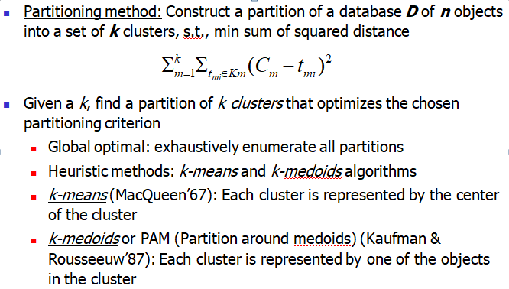
K-Means Clustering

Slide 14
K-Means Clustering
Kmeans algorithm is an iterative algorithm that tries to partition the dataset into K pre-defined distinct non-overlapping subgroups (clusters) where each data point belongs to only one group.
It tries to make the intra-cluster data points as similar as possible while also keeping the clusters as different (far) as possible.
It assigns data points to a cluster such that the sum of the squared distance between the data points and the cluster’s centroid (arithmetic mean of all the data points that belong to that cluster) is at the minimum.
The less variation we have within clusters, the more homogeneous (similar) the data points are within the same cluster.

Slide 15
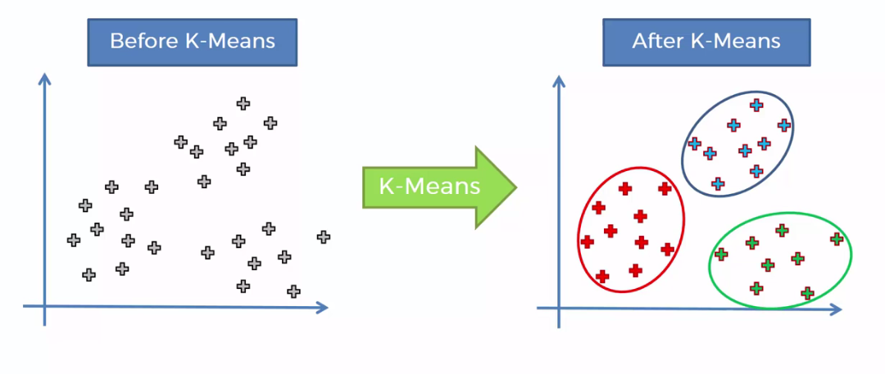

Slide 16
There are many different types of clustering methods, but k-means is one of the oldest and most approachable. These traits make implementing k-means clustering in Python reasonably straightforward, even for novice programmers and data scientists.
Two-step process: expectation-maximization
The expectation step assigns each data point to its nearest centroid. Then, the maximization step computes the mean of all the points for each cluster and sets the new centroid

Slide 17
k-Means Algorithm
Algorithm: k-Means clustering
Input: D is a dataset containing n objects, k is the number of cluster
Output: A set of k clusters
Steps:
Randomly choose k objects from D as the initial cluster centroids.
For each of the objects in D do
Compute distance between the current objects and k cluster centroids
Expectation: Assign the current object to that cluster to which it is closest.
Maximization: Compute the “cluster centers” of each cluster. These become the new cluster centroids.
Repeat step 2-3 until the convergence criterion is satisfied
Stop

Slide 18
transforming numerical features
The process of transforming numerical features to use the same scale is known as feature scaling.
Example: Data sets usually contain numerical features that have been measured in different units, such as height (in inches) and weight (in pounds.
It’s an important data preprocessing step for most distance-based machine learning algorithms because it can have a significant impact on the performance of your algorithm.
StandardScaler class: This class implements a type of feature scaling called standardization. Standardization scales, or shifts, the values for each numerical feature in your dataset so that the features have a mean of 0 and standard deviation of 1:

Slide 19
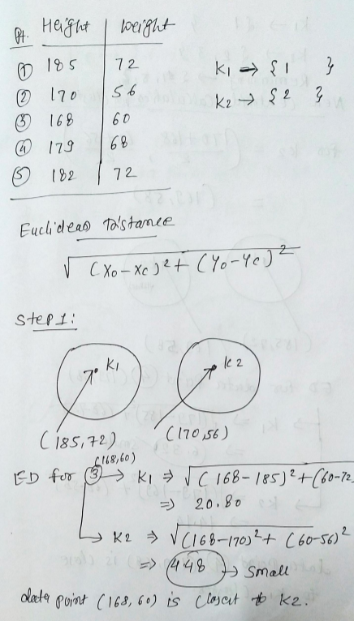
Example 1:

Slide 20
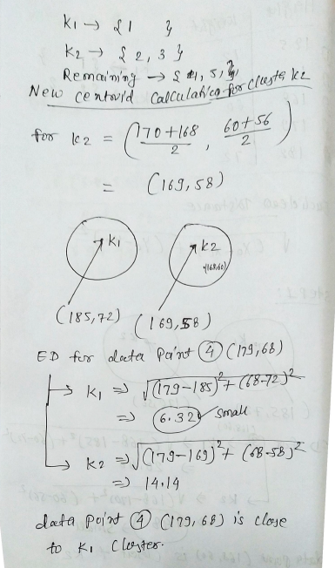

Slide 21
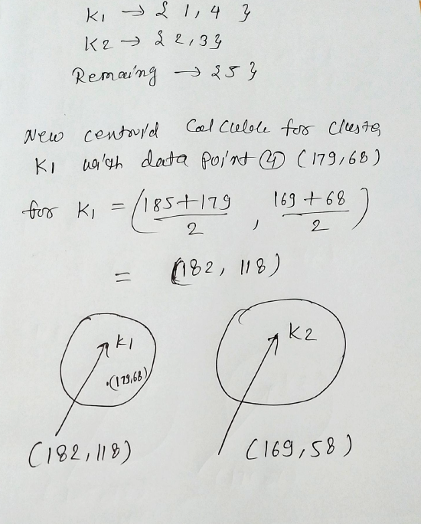

Slide 22
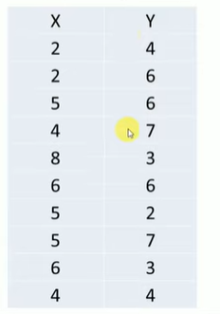
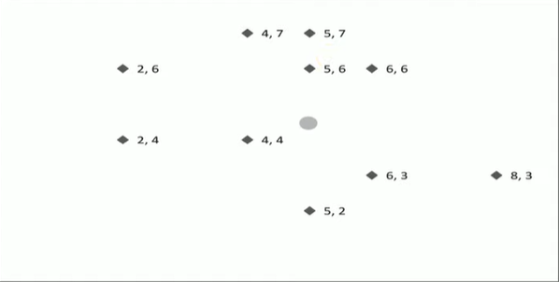
K means clustering Example

Slide 23
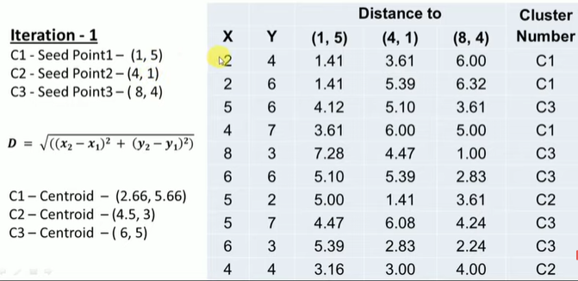

Slide 24
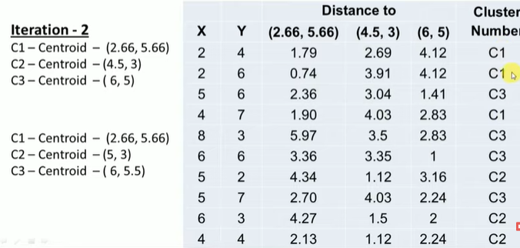

Slide 25
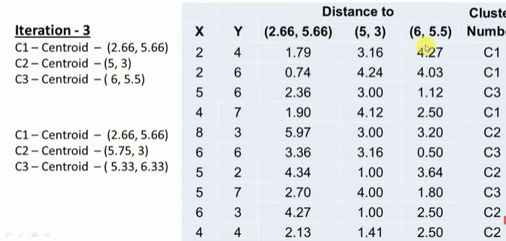

Slide 26
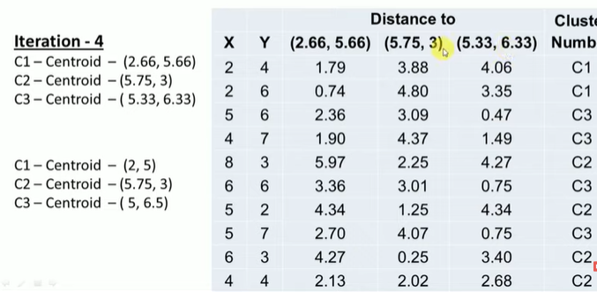

Slide 27
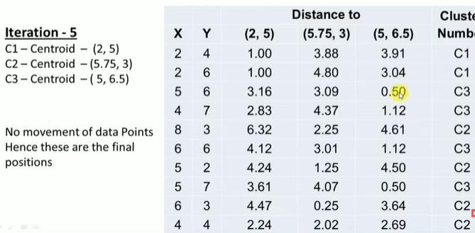
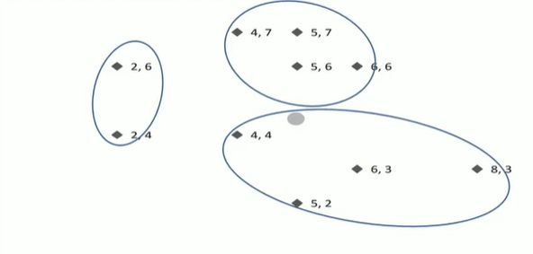

Slide 28

Example 2: k-Means clustering algorithms
Table 1.1: 16 objects with two attributes $A_{1}$ and $A_{2}$.
Fig 1.1: Plotting data of Table 16.1
A₁ | A₂
6.8 | 12.6
0.8 | 9.8
1.2 | 11.6
2.8 | 9.6
3.8 | 9.9
4.4 | 6.5
4.8 | 1.1
6.0 | 19.9
6.2 | 18.5
7.6 | 17.4
7.8 | 12.2
6.6 | 7.7
8.2 | 4.5
8.4 | 6.9
9.0 | 3.4
9.6 | 11.1

Slide 29
Illustration of k-Means clustering algorithms
Suppose, k=3. Three objects are chosen at random shown as circled (see Fig 1.1). These three centroids are shown below.
Initial Centroids chosen randomly
Let us consider the Euclidean distance measure (L₂ Norm) as the distance measurement in our illustration.
Let d₁, d₂ and d₃ denote the distance from an object to c₁, c₂ and c₃ respectively. The distance calculations are shown in Table 1.2.
Assignment of each object to the respective centroid is shown in the right-most column and the clustering so obtained is shown in Fig 1.2.
Centroid |  | Objects
 | A1 |  | A2
c₁ | 3.8 |  | 9.9
c₂ | 7.8 |  | 12.2
c₃ | 6.2 |  | 18.5

Slide 30
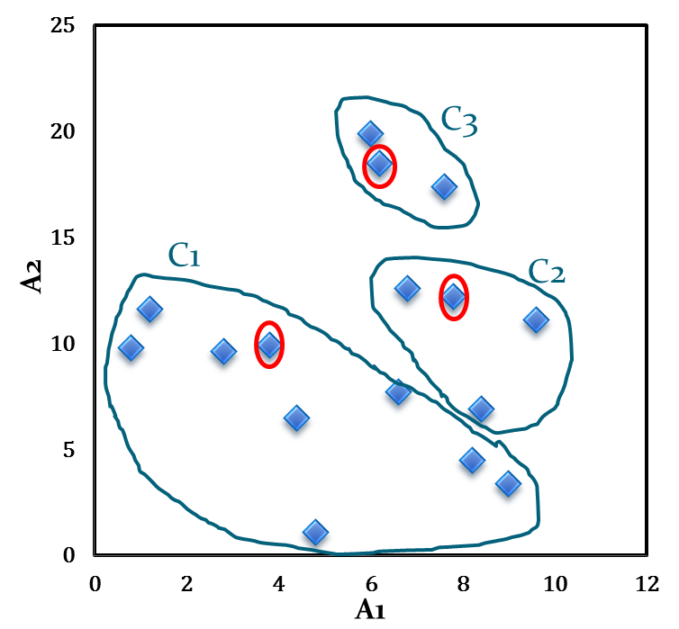
Illustration of k-Means clustering algorithms
Table 1.2: Distance calculation
Fig 1.2: Initial cluster with respect to Table 1.2
A₁ | A₂ | d₁ | d₂ | d₃ | _{cluster}
6.8 | 12.6 | 4.0 | 1.1 | 5.9 | 2
0.8 | 9.8 | 3.0 | 7.4 | 10.2 | 1
1.2 | 11.6 | 3.1 | 6.6 | 8.5 | 1
2.8 | 9.6 | 1.0 | 5.6 | 9.5 | 1
3.8 | 9.9 | 0.0 | 4.6 | 8.9 | 1
4.4 | 6.5 | 3.5 | 6.6 | 12.1 | 1
4.8 | 1.1 | 8.9 | 11.5 | 17.5 | 1
6.0 | 19.9 | 10.2 | 7.9 | 1.4 | 3
6.2 | 18.5 | 8.9 | 6.5 | 0.0 | 3
7.6 | 17.4 | 8.4 | 5.2 | 1.8 | 3
7.8 | 12.2 | 4.6 | 0.0 | 6.5 | 2
6.6 | 7.7 | 3.6 | 4.7 | 10.8 | 1
8.2 | 4.5 | 7.0 | 7.7 | 14.1 | 1
8.4 | 6.9 | 5.5 | 5.3 | 11.8 | 2
9.0 | 3.4 | 8.3 | 8.9 | 15.4 | 1
9.6 | 11.1 | 5.9 | 2.1 | 8.1 | 2

Slide 31
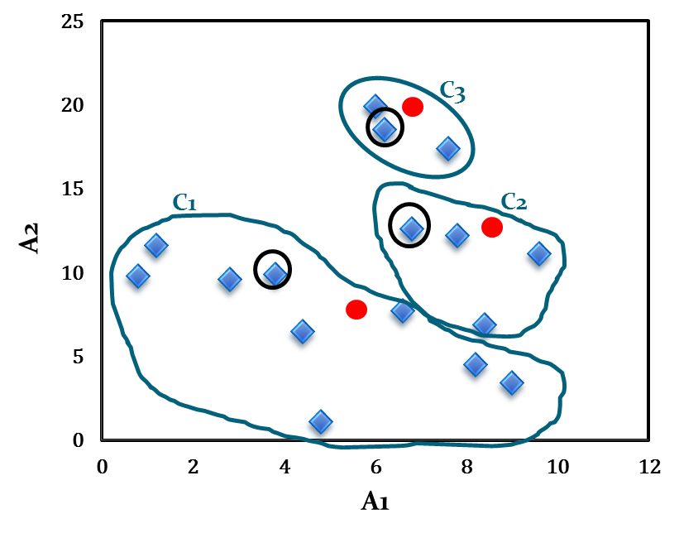
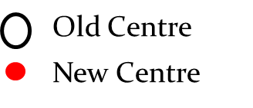
Illustration of k-Means clustering algorithms
The calculation new centroids of the three cluster using the mean of attribute values of A₁ and A₂ is shown in the Table below. The cluster with new centroids are shown in Fig 1.3.
Calculation of new centroids
New Centroid |  | Objects
 | A1 |  | A2
c₁ | 4.6 |  | 7.1
c₂ | 8.2 |  | 10.7
c₃ | 6.6 |  | 18.6
Fig 1.3: Initial cluster with new centroids

Slide 32
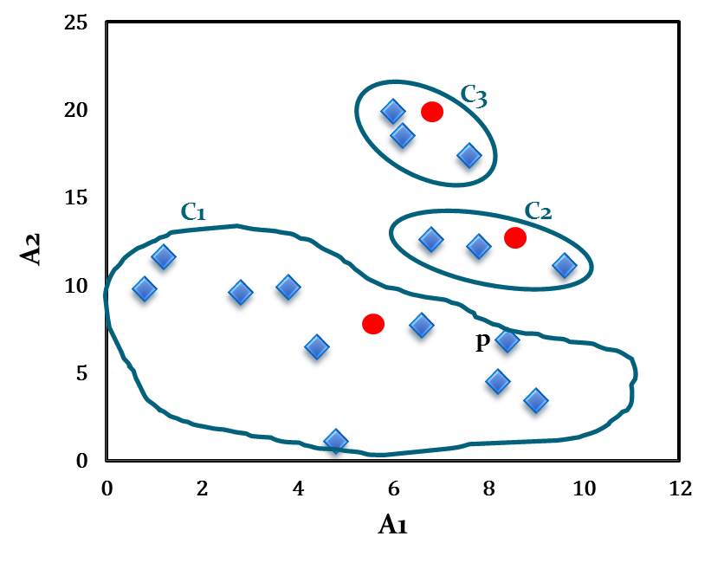
Illustration of k-Means clustering algorithms
We next reassign the 16 objects to three clusters by determining which centroid is closest to each one. This gives the revised set of clusters shown in Fig 1.4.
Note that point p moves from cluster C₂ to cluster C₁.
Fig 1.4: Cluster after first iteration

Slide 33
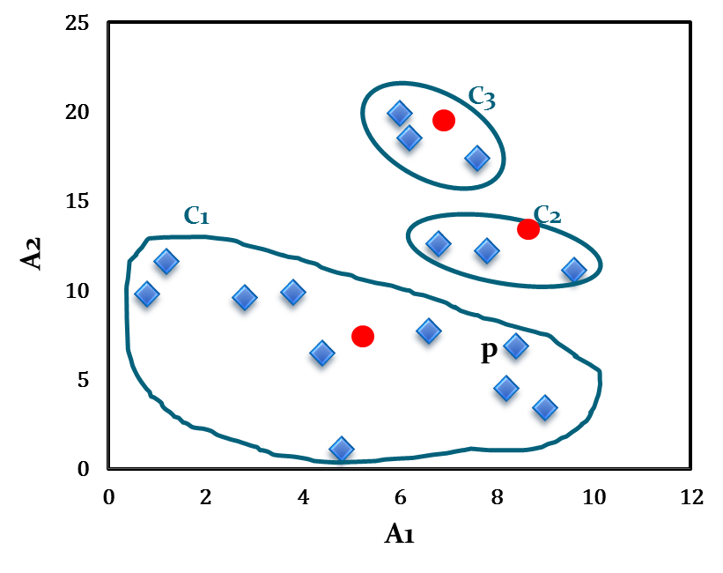
Illustration of k-Means clustering algorithms
The newly obtained centroids after second iteration are given in the table below. Note that the centroid c₃ remains unchanged, where c₂ and c₁ changed a little.
With respect to newly obtained cluster centres, 16 points are reassigned again. These are the same clusters as before. Hence, their centroids also remain unchanged.
Considering this as the termination criteria, the k-means algorithm stops here. Hence, the final cluster in Fig 1.5 is same as Fig 1.4.
Fig 1.5: Cluster after Second iteration
Cluster centres after second iteration
Centroid | Revised Centroids
 | A1 | A2
c₁ | 5.0 | 7.1
c₂ | 8.1 | 12.0
c₃ | 6.6 | 18.6

Slide 34
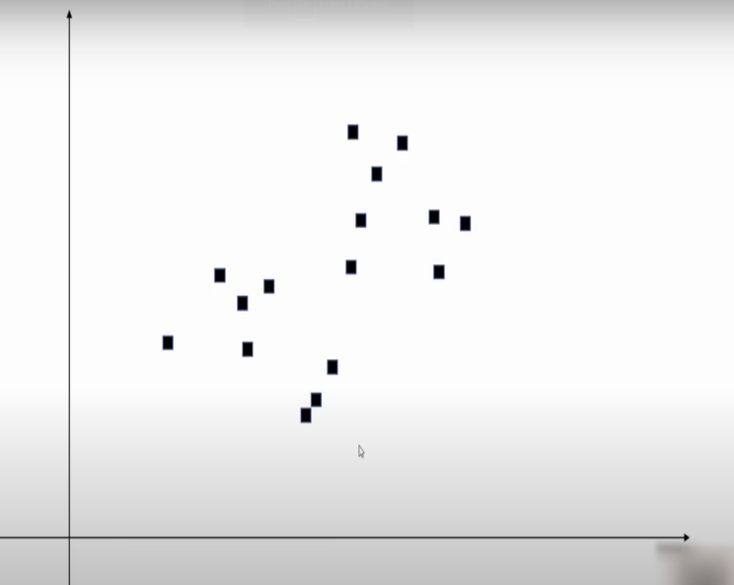
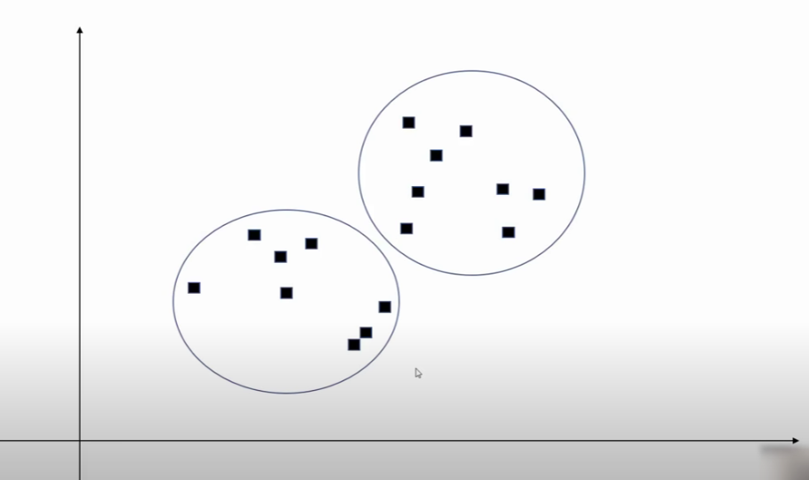
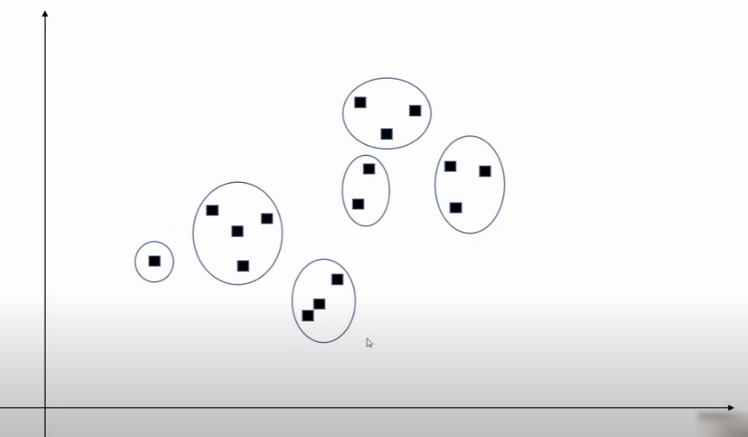
How to decide number of clusters

Slide 35
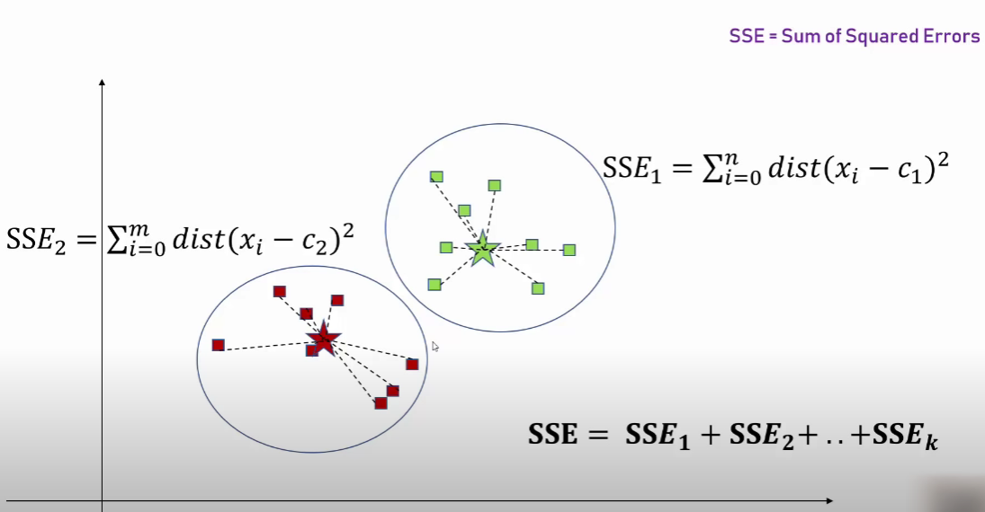
Choosing the Appropriate Number of Clusters elbow method
To perform the elbow method, run several k-means, increment k with each iteration, and record the SSE.
sum of the squared error (SSE): The SSE is defined as the sum of the squared Euclidean distances of each point to its closest centroid. Since this is a measure of error, the objective of k-means is to try to minimize this value.

Slide 36
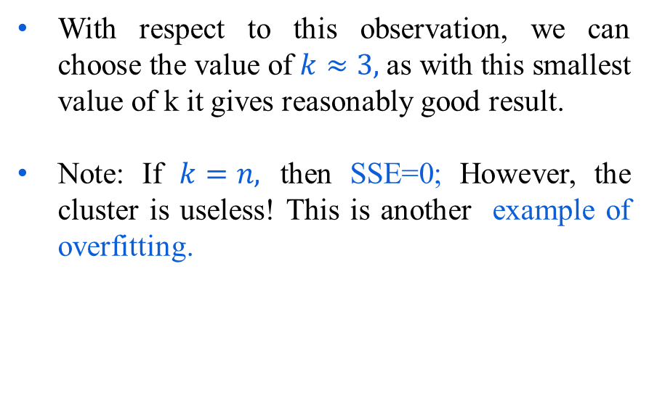
Comments on k-Means algorithm
Example 1.1: k versus cluster quality
With reference to an arbitrary experiment, suppose the following results are obtained.
k | SSE
1 | 62.8
2 | 12.3
3 | 4.4
4 | 9.3
5 | 9.2
6 | 9.1
7 | 9.05
8 | 9.0

Slide 37
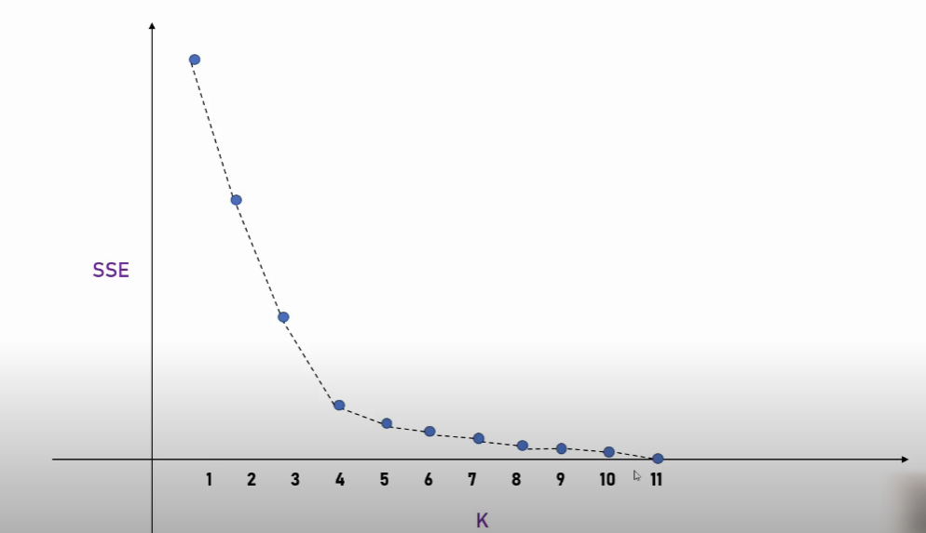
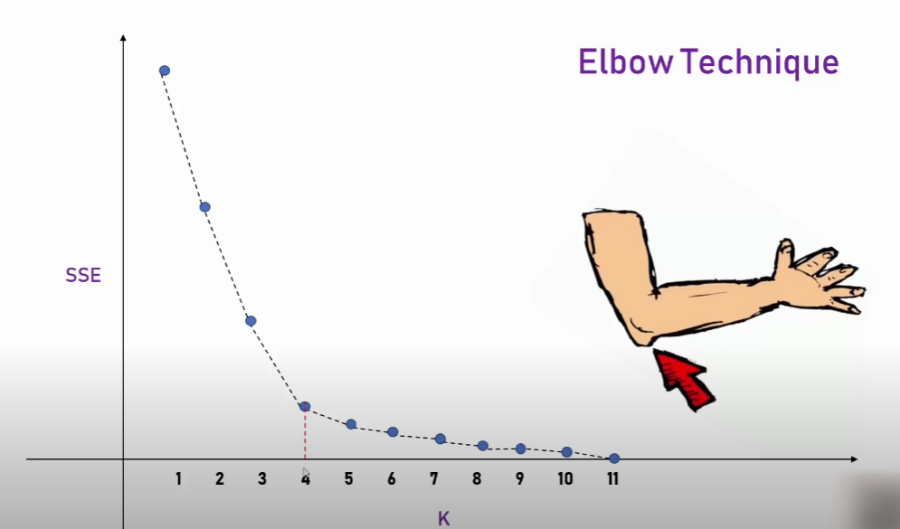
Elbow Plot

Slide 38
Applications
Document Classification
Delivery Store Optimization
Customer Segmentation
Insurance Fraud Detection etc.

Slide 39
K-medoids Algorithm
The k-medoids algorithm is a clustering approach related to k-means clustering for partitioning a data set into k groups or clusters. In k-medoids clustering, each cluster is represented by one of the data point in the cluster. These points are named cluster medoids. A medoid can be defined as the point in the cluster, whose dissimilarities with all the other points in the cluster is minimum.
The dissimilarity of the medoid(Ci) and object(Pi) is calculated by using E = |Pi - Ci|
The k-medoids algorithm requires the user to specify k, the number of clusters to be generated (like in k-means clustering).

Slide 40
K-medoids Algorithm
Algorithm:
1. Initialize: select k random points out of the n data points as the medoids. 2. Associate each data point to the closest medoid by using any common distance metric methods. 3. While the cost decreases: For each medoid m, for each data o point which is not a medoid: 1. Swap m and o, associate each data point to the closest medoid, recompute the cost. 2. If the total cost is more than that in the previous step, undo the swap.

Slide 41
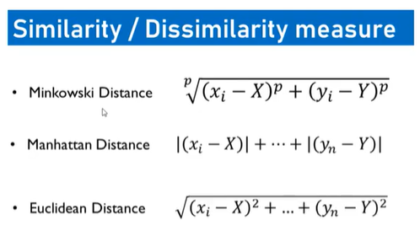
K medoids Clustering

Slide 42
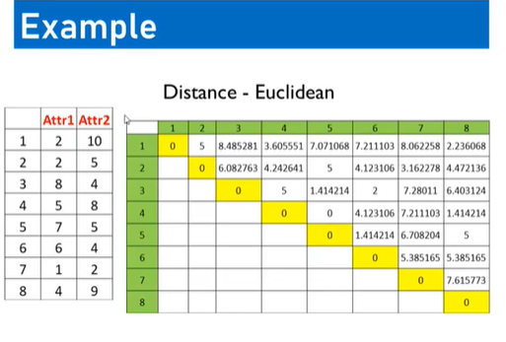

Slide 43
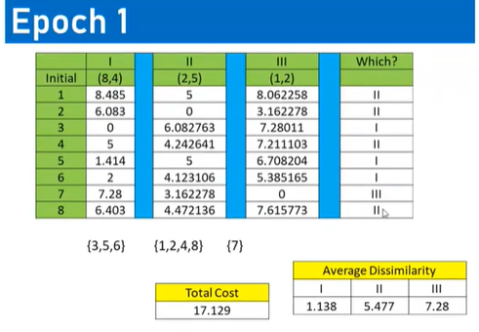

Slide 44
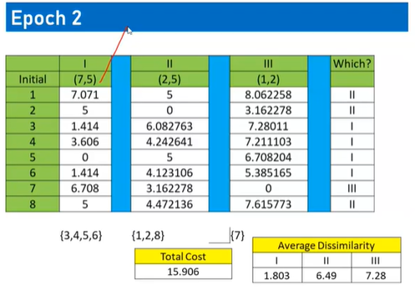

Slide 45
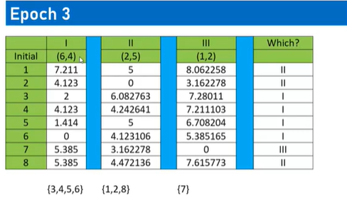

Slide 46
Hierarchical Clustering
Hierarchical Methods
This method creates a hierarchical decomposition of the given set of data objects. We can classify hierarchical methods on the basis of how the hierarchical decomposition is formed. There are two approaches here −
Agglomerative Approach
Divisive Approach
Agglomerative Approach
This approach is also known as the bottom-up approach. In this, we start with each object forming a separate group. It keeps on merging the objects or groups that are close to one another. It keep on doing so until all of the groups are merged into one or until the termination condition holds.
Divisive Approach
This approach is also known as the top-down approach. In this, we start with all of the objects in the same cluster. In the continuous iteration, a cluster is split up into smaller clusters. It is down until each object in one cluster or the termination condition holds. This method is rigid, i.e., once a merging or splitting is done, it can never be undone.

Slide 47
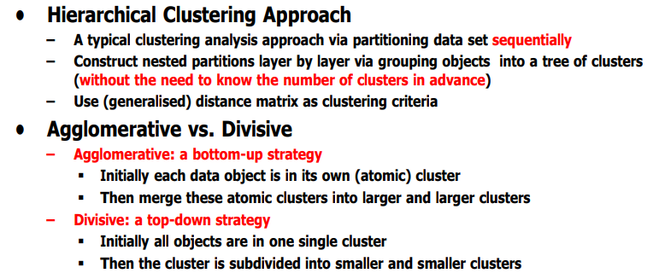

Slide 49
The agglomerative hierarchical clustering algorithm is a popular example of HCA. To group the datasets into clusters, it follows the bottom-up approach. It means, this algorithm considers each dataset as a single cluster at the beginning, and then start combining the closest pair of clusters together. It does this until all the clusters are merged into a single cluster that contains all the datasets.
This hierarchy of clusters is represented in the form of the dendrogram.

Slide 50
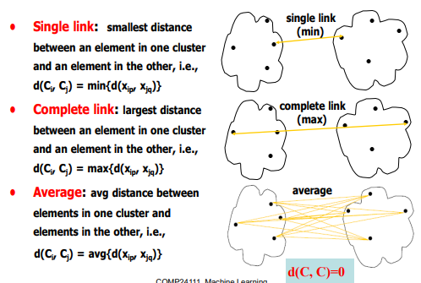
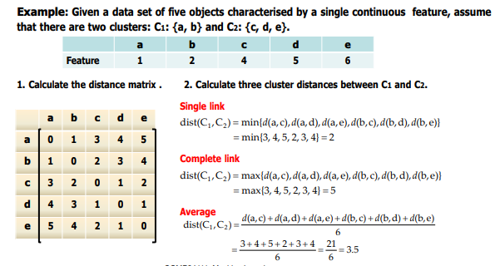

Slide 51
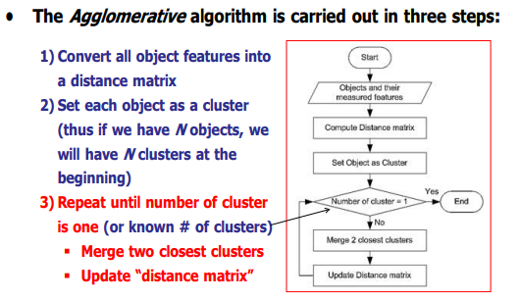
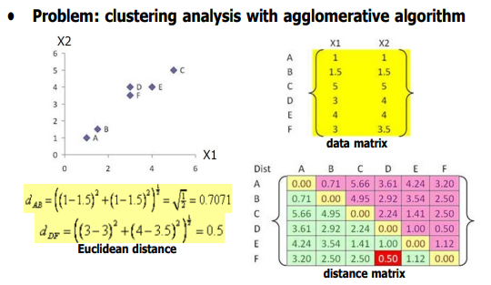

Slide 52
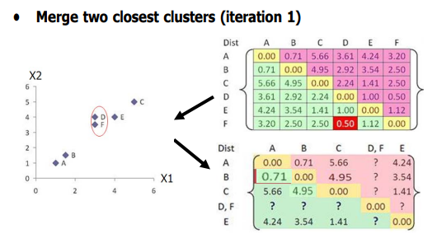
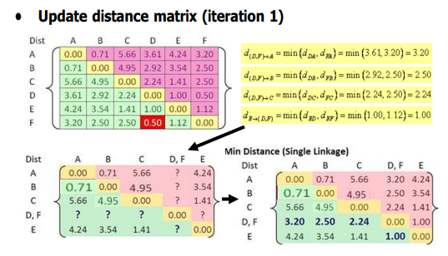

Slide 53
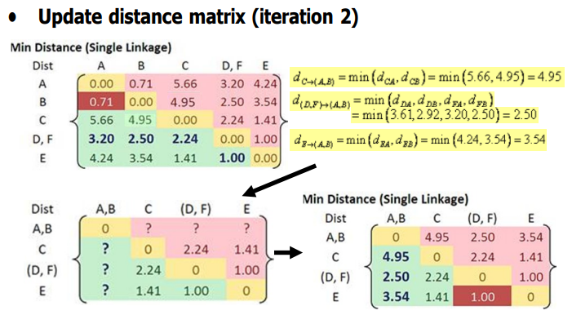
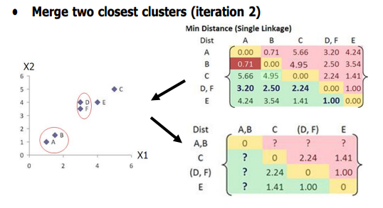

Slide 54
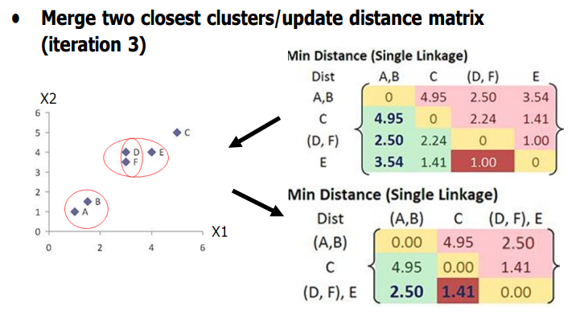
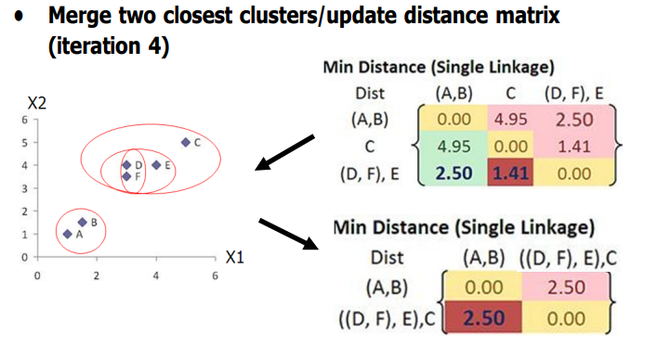

Slide 55
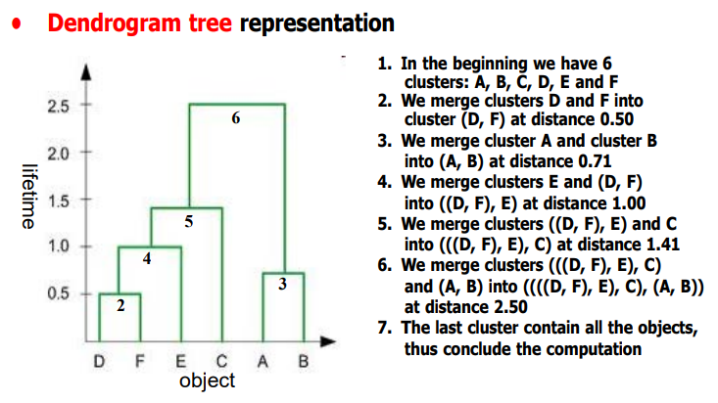

Slide 56


Slide 57


Slide 59

Agglomerative Approach
Agglomerative Clustering is a bottom-up approach, initially, each data point is a cluster of its own, further pairs of clusters are merged as one moves up the hierarchy.
Steps of Agglomerative Clustering:
Initially, all the data-points are a cluster of its own.
Take two nearest clusters and join them to form one single cluster.
Proceed recursively step 2 until you obtain the desired number of clusters.
Example 1:
Let’s say we have six data points A, B, C, D, E, F.

Slide 60
Step-1: Consider each alphabet as a single cluster and calculate the distance of one cluster from all the other clusters.
Step-2: In the second step comparable clusters are merged together to form a single cluster. Let’s say cluster (B) and cluster (C) are very similar to each other therefore we merge them in the second step similarly with cluster (D) and (E) and at last, we get the clusters [(A), (BC), (DE), (F)]
Step-3: We recalculate the proximity according to the algorithm and merge the two nearest clusters([(DE), (F)]) together to form new clusters as [(A), (BC), (DEF)]
Step-4: Repeating the same process; The clusters DEF and BC are comparable and merged together to form a new cluster. We’re now left with clusters [(A), (BCDEF)].
Step-5: At last the two remaining clusters are merged together to form a single cluster [(ABCDEF)].

Slide 61
Divisive Clustering:
The divisive clustering algorithm is a top-down clustering approach, initially, all the points in the dataset belong to one cluster and split is performed recursively as one moves down the hierarchy.
Steps of Divisive Clustering:
Initially, all points in the dataset belong to one single cluster.
Partition the cluster into two least similar cluster
Proceed recursively to form new clusters until the desired number of clusters is obtained.
Example 1:
We can say that the Divisive Hierarchical clustering is precisely the opposite of the Agglomerative Hierarchical clustering. In Divisive Hierarchical clustering, we take into account all of the data points as a single cluster and in every iteration, we separate the data points from the clusters which aren’t comparable. In the end, we are left with N clusters.

Slide 62

Figure – Divisive Hierarchical clustering

